Slide 1
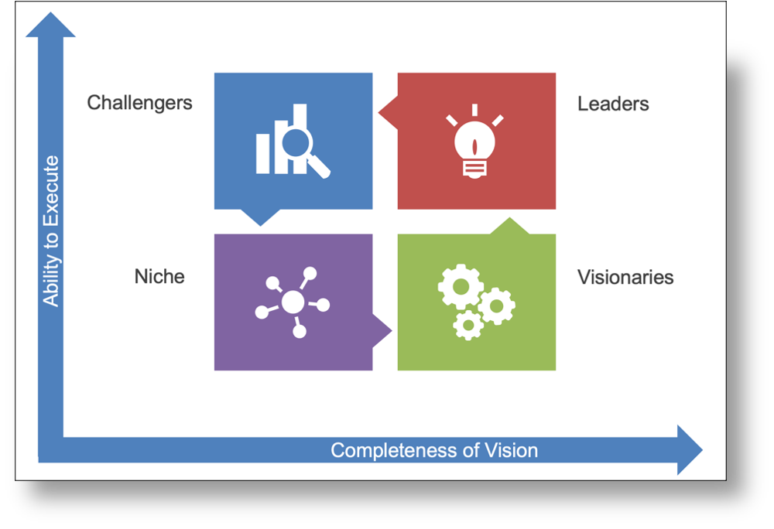

Slide 2

Cannot be imitated
Legal copyrights and patents, unique locations, unique physical assets.
Difficult to imitate
Brand image and reputation, customer loyalty, company culture and employee motivation, networks and alliances.
Can be imitated at a cost
Skilled workforce, customer service, product development capabilities, physical resources.
Easy to imitate
Unskilled workforce, undifferentiated products and services.
Explore a wide variety of strategy templates in Aha! FREE for 30-days.

Slide 3
The potential offer
Additional benefits not currently provided that could be considered as ways to augment the offer.
The augmented offer
Additional benefits not normally provided with the core offer that differentiate from competitors’ offers.
The expected offer
Additional benefits normally provided with the core offer.
The expected offer
The basic offer
The core product or service offered.
Explore a wide variety of strategy templates in Aha! FREE for 30-days.

Slide 4
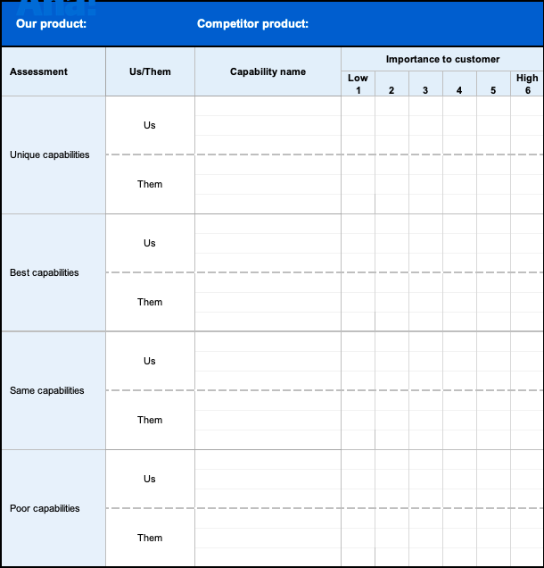
Explore a wide variety of strategy templates in Aha! FREE for 30-days.

Slide 5
